Slide 1
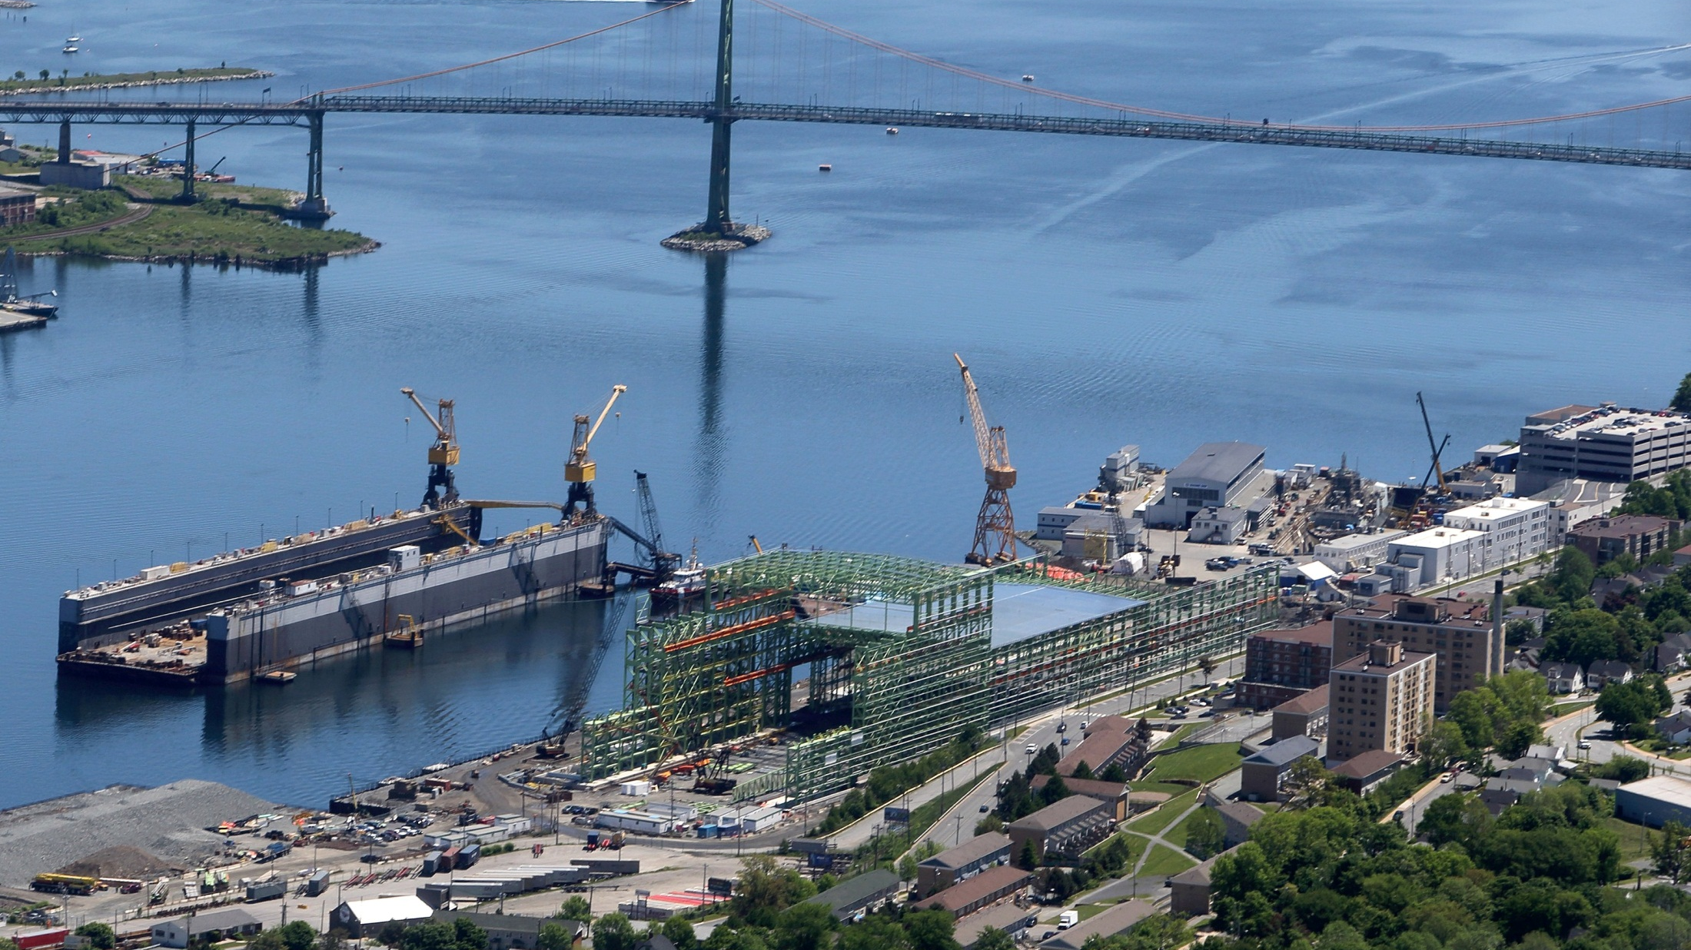
Irving Shipbuilding: Ships to Start Sept. 2015
Canadian Science Policy Conference
October 16, 2014
This presentation contains confidential financial, commercial, scientific and/or technical information and/or trade secrets of Irving Shipbuilding Inc. No Distribution is permitted

Slide 2
Defense Procurement Strategy
IRB to ITB; Value Prop + New Value Prop
Forward thinking; challenging without all information
Big commitment; extra work but hard to argue value to Canada
Value to Canada still eminent – develop ecosystem here & continue to build Canada’s capacity
Economic Benefits
Direct: Supporting Canadian Companies
Indirect: Aspen Kemp Associates & NSCC

Slide 3
Procurement Strategy
Building Capacity in Canada
ISI continues to be supportive of and involved in:
Supplier Development Sessions
Industry Sessions
DEFSEC
CANSEC
Conferences
Meetings
Tours
Evaluation Criteria
1
Appropriate Equipment for Navy
3
Industrial & Regional Benefits for Canada
4
Support of SME’s & Minority Businesses
2
Cost Effective – Value to Canada

Slide 4
Sourcing Canadian Content
Flow down 100% Canadian Content Obligation
Capitalize on Tier 1’s ability to over-achieve on obligation
Tier 1’s/Major Subcontractors
Eligible Parties
Province
Tier 2’s
JDI Companies
Continue to source Indirect IRB opportunities from JDI
Ex. IWK Health Centre Research (ISI & KBS)
Ex. DAL Research Chair in Occupational Medicine (JDI)
Continue to make vendors Eligible Parties & solicit IRBs where we can
Maximize Canadian Content obtained
Request IRB plan as part of procurement process
Engage offshore companies with supply to ISI to establish Canadian presence
This presentation contains confidential financial, commercial, scientific and/or technical information and/or trade secrets of Irving Shipbuilding Inc. No Distribution is permitted

