Slide 1
DATA MANAGEMENT PLANS WORKSHOP
Social Sciences and Humanities Research Council
Conseil de recherches en sciences humaines

Slide 2
Walter Stewart, Co-ordinator Research Data Canada - Moderator
Christine Trauttsmansdorff, Executive Director, Social Sciences and Humanities Research Council on behalf of Canada’s Funding Agencies – The TC3+ Plans for DMP
Chuck Humphrey, University of Alberta
Ernie Boyko, Carleton University sponsored by the Canadian Association of Research Libraries. Data Management Plans: Policy and Practice

Slide 3
Panel 12 Data Management Plans: Policy and Practice
Canadian Science Policy Conference
Halifax – October 2014

Slide 4
Why data management? Why now?
Excellence in data management is fundamental to research excellence
Allows research results to be as freely available and accessible as possible, while ensuring that appropriate safeguards are in place.
Research data management practices and policies are evolving quickly in leading research countries.
Data management capacity is increasingly linked to Canada’s international competitiveness.

Slide 5
Tri-Agency / CFI Consultation – Fall 2013
“Capitalizing on Big Data: Toward a Policy Framework for Advancing Digital Scholarship in Canada”
Discussed ways the agencies can promote excellence in data management practices and help to establish a “Culture of Stewardship” in Canada
Proposed that data management plans be required as part of grant applications
Highlighted the need for ongoing coordination with other players in the « research ecosystem »

Slide 6
Tri-Agency Approach
Data management requirements will impact researchers, students and institutions, among others
Long-term success depends on availability of standards, repositories, expertise and other resources.
Education and awareness activities, sharing best practices, etc. are essential
Coordination, consultations and communications are essential
Parallel consultations on the Government of Canada Open Government / Open Science initiatives

Slide 7
GoC Open Government / Open Science
Government of Canada initiative to maximize access to federally-funded scientific research, to encourage greater collaboration and engagement with the scientific community, the private sector, and the public.
G8 Science Ministers Agreement: "to promote policies that increase access to the results of publicly funded research results to spur scientific discovery, enable better international collaboration and coordination of research, enhance the engagement of society and help support economic prosperity".

Slide 8
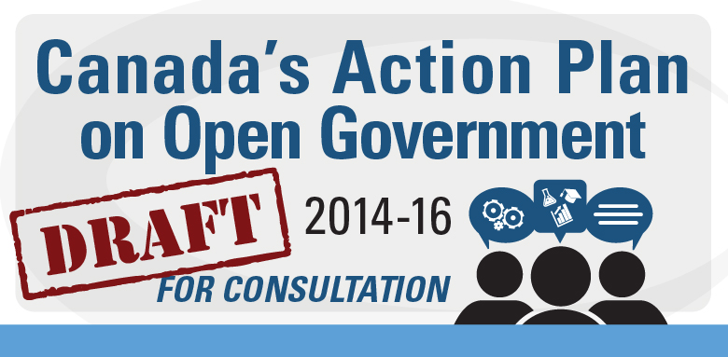
Consultation open to October 20th, 2014

Slide 9
Tri-Agency: Next Steps
Fall/winter 2014-15:
Tri-agency working group with RDC and CAURA observers
Participation in discussions such as CSPC, CASRAI, CAURA, CARL, etc.
Environmental scan: K. Shearer
External advisory group
Promotion and awareness
2015
Public consultation on proposed policy direction
Guiding principles, pilots, guidance documents, etc.
Determine next steps

Slide 10
Contact Points
Jeremy.Geelen@sshrc-crsh.gc.ca
Philippe-Olivier.Giroux@nserc-crsng.gc.ca
Jessica.Mankowski@cihr-irsc.gc.ca

Slide 11
Data Management Plans: Policy and Practice Workshop
Canadian Science Policy Conference 2014
Chuck Humphrey, University of Alberta
Ernie Boyko & Wendy Watkins, Carleton University

Slide 12
Outline
Workshop objectives
Context for Data Management Plans (DMPs)
Why research data management
Drivers and uptake
DMP purpose, process, and practice
Purpose: values associated with data principles
Process: procedures and guidelines
Practice: templates and tools
An exercise

Slide 13
After this workshop, you should be able to:
Describe to a colleague the purpose and use of a DMP,
Understand the driver or drivers for DMPs that apply to your research context,
Have a knowledge of the tools to produce a DMP, and
Complete a draft DMP using DMP Builder.

Slide 14
DMP defined: form and function
A data management plan is a formal statement that describes how a researcher will address specific topics on the production and stewardship of data both during and after a research project is completed.
It facilitates research data management to support the research project as well as broader institutional and funder objectives.
Sustain data sharing and re-use.

Slide 15
What is research data management?
The process of controlling the research administrative information and data generated during a research project.
An integral part of the research process
DM is particularly challenging when studies involve several researchers and/or when studies are conducted from multiple locations.
Depends on
how they are produced and used throughout the research lifecycle,
the types of data involved,
how data are collected, stored, shared, & preserved.
(Adapted from Penn State University Libraries Publishing and Curation Services: http://www.libraries.psu.edu/psul/pubcur/what_is_dm.html)
Notes:
Wendy Do we want to mention the methodological as well as the administrative information? And in the “depends on” add the word modified to the first bullet? I realize produced may cover it but folks don’t tend to keep the metadata on the algorithms on constructed variables .

Slide 16
Benefits of research data management planning
Helps to identify issues and strategies early in your research project.
Confirms that you have documented your compliance with institutional and funder policies and ethics approval requirements.
Provides focus on data sharing and re-use opportunities of your research data.
Charts a pathway for your research data to remain useful and to be preserved for future use.
Ensures that any questions regarding your findings can be validated using your data.
(Adapted from the University of Sheffield, University Library http://www.sheffield.ac.uk/library/rdm/dmp)
Notes:
Jane

Slide 17
Key drivers behind DMPs
Data sharing
Reproducible research
Managing digital assets
e-Science, cyberinfrastructure, and big data

Slide 18
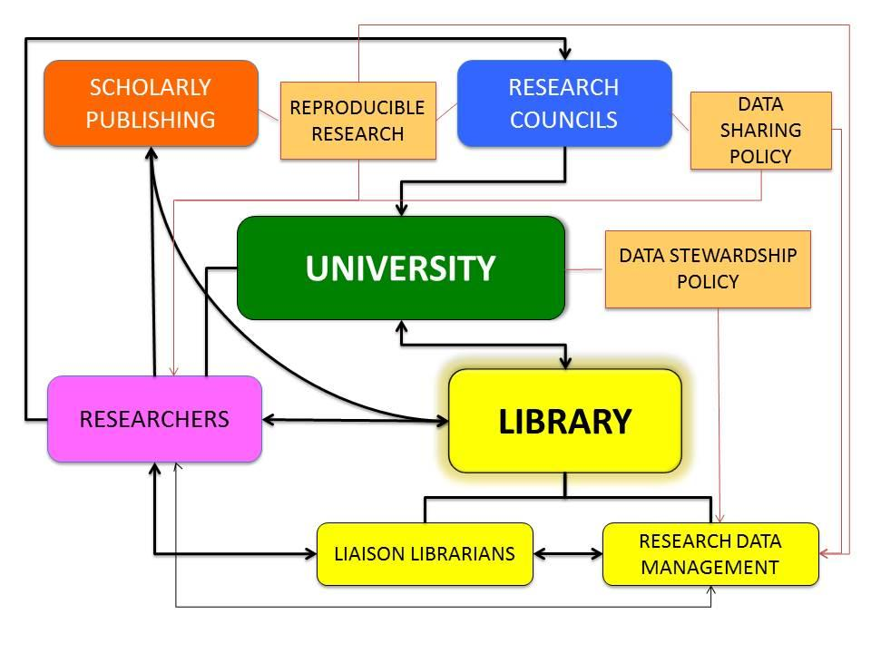

Slide 19
Data sharing
Data archives have been enabling the sharing of data for over 5 decades (e.g.,ICPSR, UKDA, Carleton)
2004 OECD
Declaration on Access to Research Data from Public Funding
UK Research Councils
“Publicly funded research data are a public good, produced in the public interest, which should be made openly available with as few restrictions as possible in a timely and responsible manner that does not harm intellectual property.”
US National Science Foundation
“[A Data Management Plan (DMP)] should describe how the proposal will conform to NSF policy on the dissemination and sharing of research results.”

Slide 20
Reproducible Research
Supports academic integrity
Journals increasingly asking for data to be deposited as condition of publishing
Compliance with funders’ expectations that research is reproducible
DMPs are instruments for reproducible research

Slide 21
Management of digital assets
Digital content (data, etc) must be managed to facilitate access and use over the long run
Data stewardship
“acquire, manage, organize, preserve, and provide access to massive amounts of data for use and re-use by a variety of
interdisciplinary and heterogeneous communities over time”
http://besser.tsoa.nyu.edu/howard/Talks/imagem-som.pdf
DMPs act as a roadmap to facilitate data stewardship

Slide 22
e-Science, cyberinfrastructure, and big data
These have been the tectonic forces generating wider attention to the need for managing research data
Jim Gray’s Fourth Paradigm argument
Introduction of “data-intensive science”
Interoperating data across multiple sources to create new data
E-science & big data became promoters of DMPs
Notes:
Do we want to add “linked data” to this slide?
I think that “interoperating” covers linked data. Linked data is one way of interoperating. (ch)

Slide 23
Examples of DMP uptake
International Polar Year DMP (2006)
Genome Canada (2009)
U.S. National Science Foundation (2011)
Research Councils of the U.K. (RCUK) (2010-12)
U.S. Department of Energy (July 2014)
International Development Research Centre
Notes:
Do we want a link to IDRC?
Yes and preferably to a page about their DMP. I confirmed that the other links on the page are to DMP references. I couldn’t find a statement by IDRC on DMPs, however. (ch)

Slide 24
DMP purposes
A DMP embodies the main elements of an organization’s data policy
Two examples
University of Alberta Research Policy and its focus on research records stewardship
Canadian High Arctic Research Station (CHARS) and its focus on access

Slide 25
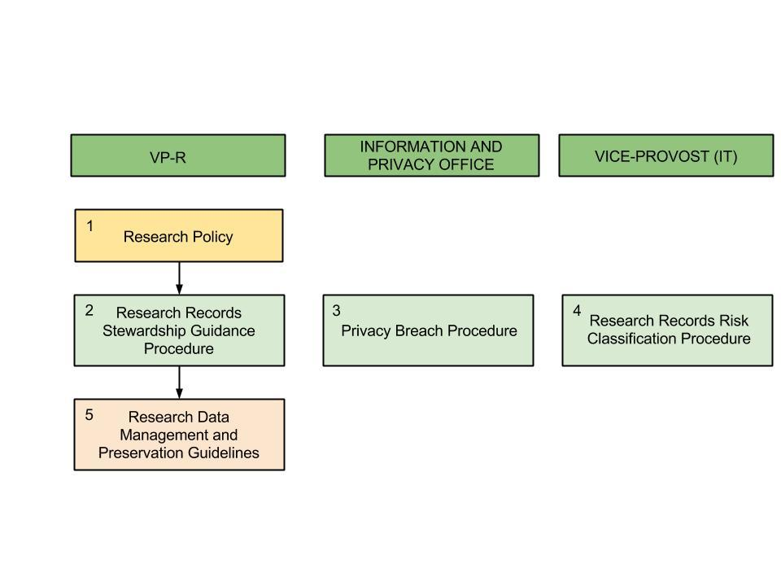
University of Alberta Research Policy

Slide 26
University of Alberta Research Policy
“Ensure that principles of stewardship are applied to research records, protecting the integrity of the assets.”
“[DM] plans recognize the stages through which research records will be produced, managed, documented, stored, disseminated and deposited (with either a staging or a preservation repository). Furthermore, these plans will identify the data stewards across a project’s lifecycle.”

Slide 27
DMP elements for digital assets
Funder and data description
Data collection
Documentation and metadata
Storage and backup
Data sharing and re-use
Preservation
Responsibilities and resources
(This template is taken from the University of Alberta’s Data Management Plan Builder, https://dmp.library.ualberta.ca/projects/my-project-university-of-alberta-template--130?show_form=yes )
Notes:
Wendy

Slide 28
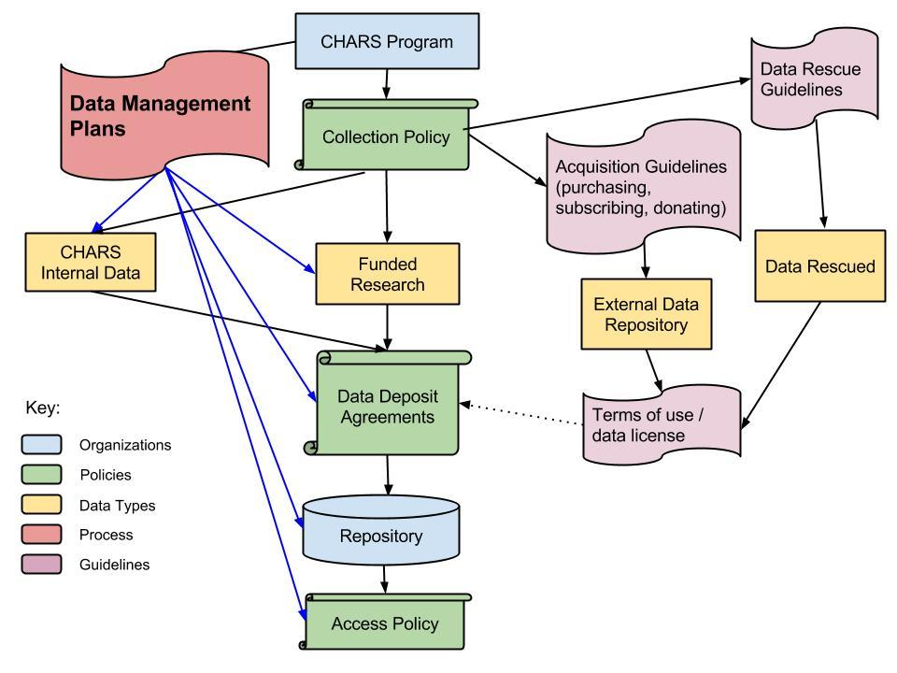

Slide 29
DMP elements for long-term access
Sources for S&T data collection
Data collection storage and backup
Documentation and metadata
Choice of data repository
Terms of data deposit
Terms of data access
Responsibilities and resources
Notes:
One of the questions that concerns researchers is that they will be responsible for long-term preservation (curation). It’s a good thing to let them know that that is the repository’s role.

Slide 30
DMPs in practice
Development of templates and tools
The central themes in an organization’s data policy act as the topics of a DMP template. Within these topics, relevant questions are asked about each area. A researcher then provides her or his answers to each question.
Tools to help with a DMP
DMPOnline (UK Digital Curation Centre)
DMP Builder (Canada U of Alberta)
DMP Tool (US California Digital Library)
Establish a consultation process to support the use of DMPs

Slide 31
DMP consultation process
Submit DMP
Start a new research project
Incorporate reviewer’s suggestions in the DMP
Meet with a librarian and review the DMP process
Third-party review of the draft DMP
Prepare an initial draft of a DMP

Slide 32
Exercise
Prepare a DMP using DMP Builder (shortened template) around depositing data in a publication with a repository.

Slide 33
Hypothetical Example
Hypothetical open access and data policies for the Canadian Science Policy Centre
Open Access: all research publications of the CSPC will be freely available to the public through the CSPC website.

Slide 34
Hypothetical Example
Data Policy: all data used as evidence in research publications of the CSPC will be made available to allow the findings to be reproduced.
A citation for each dataset in an article or report will be included.
All data will be discoverable through the use of persistent identifiers (handles or digital object identifiers) and preferably registered with DataCite Canada.

Slide 35
Hypothetical Example
Data Policy: all data used as evidence in research publications of the CSPC will be made available to allow the findings to be reproduced.
Intelligent access to data will be provided to ensure that confidentiality is protected.

Slide 36
Intelligent Access
Intelligent access employs data management methods and services that best align user needs with the access control deemed necessary for a particular dataset.
Examples of intelligent access:
using visualization techniques to explore data without having to transport it,
co-locating “big data” with high performance computing,
aggregating data to guard against disclosure while safeguarding sensitive content,
providing secure environments for analyzing sensitive data, and
performing data linkages in a controlled setting.

Slide 37
Hypothetical Example
Will this CSPC publication involve the use of data?
No.
No DMP required
Yes.
Sources of the data
Data collected by the researcher
Data from other data providers
Requirement for special software or code
No: go to next item
Yes: steps to provide access to code

Slide 38
Hypothetical Example
Are there any restrictions on the data being used?
No.
Go to the next item.
Yes.
Confidentiality of research participants
Need for informed consent about reuse of the data
Data from another producer
Does the producer allow the data to be redisseminated?

Slide 39
Hypothetical Example
Will you deposit your data with a data repository?
No.
How will you make your data available?
Yes.
Which data repository will you use?
Does this repository issue persistent identifiers, such as DOIs, for research data?
No.
How will you obtain a persistent identifier for your data?

Slide 40
Hypothetical Example
i. Which data repository will you use?
Does this repository issue persistent identifiers for research data?
No.
How will you obtain a persistent identifier for your data
Yes.
Will this data repository register data DOIs with DataCite?
No.
Manually enter DOI
Yes.
Requirement met

Slide 41
Hypothetical Example
i. Which data repository will you use?
Does this repository support intelligent access?
No.
If 2b-i is No, exit
If 2b-i is Yes, how will you protect confidential information?
Yes.
If 2b-i is No, exit
If 2b-i is Yes, select an appropriate way to protect confidential information

Slide 42
Hypothetical Example
Data citation
Has a citation format for datasets been identified?

