Slide 1
CSPC 2014
The crucial role of small and medium size universities for advancing Canadian social and economic development
Quebec Regions
André Manseau
Dean of Research
UQO

Slide 2
Université du Québec – A regional presence across Quebec

Slide 3
UQ Network
10 universities/constituancies across Quebec – a strong presence and contribution to socio-economic development in regions
Some evidences :
Abitibi-Temiscamingue region - 70% of the workforce holding an university degree graduated at UQAT
Gaspesie region – UQAR created an important innovation centre in fisheries and aquaculture (MERINOV), in collaboration with Quebec government (MAPAQ) and local enterprises
Trois-Rivières region - One of the most important international research centre on SMEs (INRPME): participation of 1,500 Canadian SMEs and 300 international since 1997
Outaouais region – A Language Technologies Research Centre (CRTL) that has mobilized 13 companies, 14 universities and over 1600 professionals and students for supporting technological innovation and transfer in the last 5 years, 10 enterprises incubated, creating 50 jobs

Slide 4
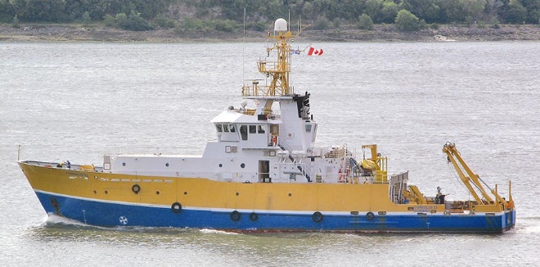
UQAR and Institute of Marine Science (ISMER)
Research
One the most important university research centre in Marine Sciences in Canada, with an international reach
Major research infrastructures, including one of the best research vessel - Coriolis ll

Slide 5
UQAR and ISMER (continued)
International research expertise, grouping more that 80 professors
Training
More that 250 HQP graduated (Master and Doctorate degrees)
Partnering with
7 other regional R&D centres
18 national and international R&D centres
6 governmental departments
9 Research networks

Slide 6
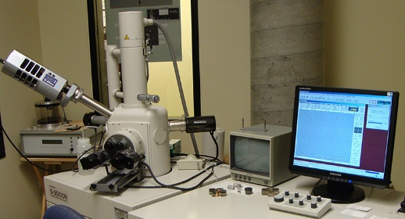
UQAT and Research Institute in Mining & Environment (IRME*)
Research
3 M$/year
Strong participation of the mining industry
Training
More than 150 HQP trained since 2001
50 students per year currently
With the mining industry
*In partnership with Polytechnique Montreal

Slide 7
UQAT and IRME
Extended industry partnerships
Agnico Eagle; Mine Canadian Malartic; Mine Raglan – Glencore; Rio Tinto Fer et Titane inc.; IAMGOLD Corporation
1,7M$/year of expert services
International research chair (UQAT-Université Cadi Ayyad, Marrakech)
Implementation of geospatial decision support system in a Kettara (Maroc) mine for managing air quality around mining
Integrated rehabilitation system with two major industrial groups in Maroc, Groupe OCP and Groupe Managem.
http://vimeo.com/69641086

Slide 8
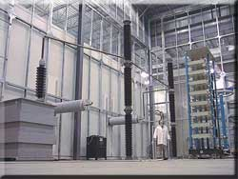
UQAC and International Research Centre on Atmospheric Icing and Power Network Engineering (CENGIVRE)
Research
International leadership in electric power distribution network engineering

Slide 9
UQAC and CENGIVRE (continued)
Training
More than 60 HQP (Master and Doctorate) graduated
Currently 15 doctorate and 8 M. Sc. students
Industry Partnering
Research funding from 17 industry partners
Including a unique laboratory for homologation of antifrosting products for planes

Slide 10
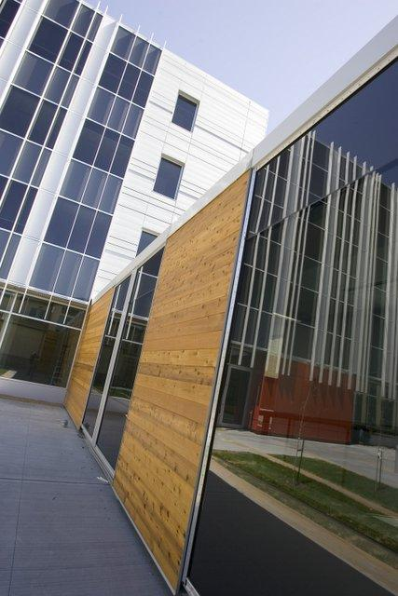
UQO and Language Technologies Research Centre (CRTL)
Supports technological innovation and transfer in information processing, translation, machine learning, decision support system, etc.
Mobilized 13 companies, 14 universities and over 1600 professionals and students in the last 5 years
10 enterprises incubated, creating 50 jobs

Slide 11
Challenges for universities in regions
Access to higher education in all regions
Support knowledge based development across the country
Sustainable development based on knowledge and expertise
Respond needs of HQP in regions – Attract and retain talents
Facilitate access to research infrastructures and expertise to all Canadian enterprises
No one-fit-all approach : Region-Specific Strategies

