Slide 1
Looking to 2020 and beyond: Training the next generation of innovation leaders in Canada
#CSPC2014
#NextGenInnovators
October 17, 2014
Notes:
Objective
Discuss the future of graduate student and postdoctoral training in Canada.
Panelists
Andre Bezanson, Postdoc, Dalhousie
Kevin Dunn, Director, Industry Liaison and Innovation, Dalhousie
Ross Laver, VP, Communications, CCCE
Val Walker, Director, Policy, Mitacs
Moderator
Rachel Brighton, President, Finest Point Periodicals Limited

Slide 2
“Productivity isn’t everything, but in the long run it is almost everything.”
Paul Krugman, Nobel Laureate (Economics)
Notes:
And we heard it yesterday… but let’s be clear – Canada has a productivity problem.

Slide 3
Productivity
What is productivity?
Output per unit of input
GDP per hour worked
Product per hour worked
Activity
Inputs
Outputs

Slide 4
Productivity
Labour: More Skills = Higher Productivity
Capital: Investments in machinery, equipment, stuff
Multifactor Productivity: Everything else not accounted for. e.g. innovation.
Activity
Inputs
Outputs

Slide 5
Productivity
Example of High Productivity:
Highly skilled workers, automation, high-tech machinery, optimal systems
Need fewer inputs to create same output. Thus freeing these inputs for production of other outputs
Or more outputs at lower cost, increasing purchasing power and profits
Activity
Inputs
Outputs
Notes:
Alternatively, low productivity results from poor training, no automation, old machinery, unoptimized systems.
Therefore, you need a lot of inputs to drive outputs.
Lots of employees
Lots of inefficient machinery

Slide 6
Productivity
Impacts of rising productivity
Firm level: increased productivity, increased salaries, increased profits, decreased costs (prices), increased competitiveness
National level: increased standard of living

Slide 7
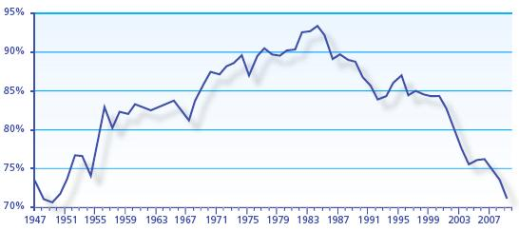
Productivity
Canada’s productivity as a % of United States
Jenkins Report, 2011

Slide 8
Productivity
How can we improve Canada’s productivity?
OECD 2012 report recommends two measures:
Improve quality and quantity of highly-educated workforce
Increased business R&D to stimulate innovation
Notes:
A question that we’ve been asking for decades… 2 things that we think about a lot at Mitacs.
Improving the quality and quantity of our workforce.
Increase business expenditure on R&D to stimulate innovation.

Slide 9
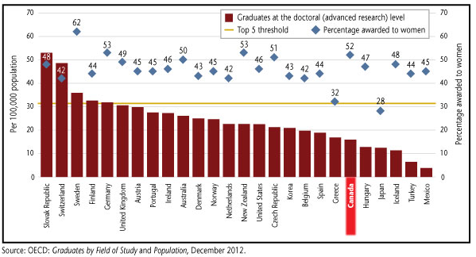
Labour Productivity
Education and Training – PhD production
Notes:
And these countries ahead of us don’t have huge demand for tenure-track professors… shows that the solution the fact that production of PhDs far outpaces our capacity for professors is NOT to produce fewer PhDs.

Slide 10
Labour Productivity
And we’re losing ground
Between 1998-2006
Canada increased per capita production of PhDs by 13%
US increased by 22%
OECD average increase of 40%

Slide 11
Labour Productivity
Education and Training – Summary
We significantly lag other leading economies in the graduation of advanced degree holders
This is particularly true among management
Discussion about skills shortages generally ignores this
Notes:
About 20% of R&D managers in US have an advanced degree (masters or PhD)… in Canada, that’s 11% (about half)

Slide 12
Today’s Panel:
Looking to 2020 and beyond: Training the next generation of innovation leaders in Canada
#CSPC2014
#NextGenInnovators

